Slide 1
Digital Portfolio
STUDENT NAME: G. SASIREKA
REGISTER NO AND NMID: 2422k0958/A7A8D3C1CF48F05BEB345FCE1D2D611B
DEPARTMENT: Bsc computer science
COLLEGE: COLLEGE/ UNIVERSITY Tiruppur kumaran college for women/Bharathiar University

Slide 2
PROJECT TITLE
Bussiness Management

Slide 3


AGENDA
Problem Statement
Project Overview
End Users
Tools and Technologies
Portfolio design and Layout
Features and Functionality
Results and Screenshots
Conclusion
Github Link
3/21/2024 Annual Review

Slide 4

PROBLEM STATEMENT
" This portfolio demonstrates the ability to identify significant business issues, understand their impact, and articulate the need for solutions, often focusing on a specific user segment and measurable business metrics.

Slide 5

PROJECT OVERVIEW
In business management, a project portfolio is a collection of related and unrelated projects, programs, and even operational work, managed collectively to achieve strategic objectives and maximize overall business value.

Slide 6

WHO ARE THE END USERS?
In business management, end-users are the people who directly use a product or service, whereas customers are the individuals or organizations that purchase it.

Slide 7

TOOLS AND TECHNIQUES
How to Build a Personal Investment Portfolio Define clear financial goals. An individual can have several goals; financial and others. ... Diversify your investment portfolio. ... Focus on long-term growth. ... Monitor performance. ... Rebalance regularly. ... Reduce risk based on goal achievement.

Slide 8
POTFOLIO DESIGN AND LAYOUT
A portfolio in business management is a strategic tool that organizes and presents your skills, work, and accomplishments to showcase your expertise and value.
8

Slide 9
FEATURES AND FUNCTIONALITY
A Business Management portfolio of features and functionality includes elements like strategic alignment, resource management, risk mitigation, and performance tracking to manage projects, products, or divisions that contribute to overall business goals. Key functionalities involve portfolio analysis, prioritization, roadmap planning, budgeting, and data-driven decision-making to optimize investments, balance demands, and drive profitability.

Slide 10
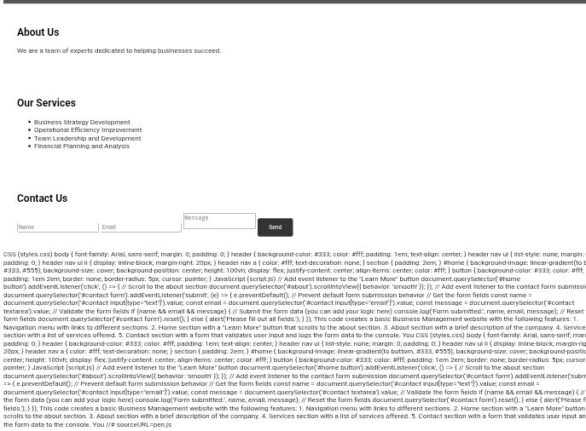

RESULTS AND SCREENSHOTS
3/21/2024 Annual Review
10

Slide 11
CONCLUSION
A "portfolio of conclusion" in Business Management refers to a collection of written works and reflective pieces that demonstrate a student's understanding of business concepts and their ability to apply them, typically at the end of an academic term or program.
11

